Slide 1
Press Freedom in East Africa: Citizens’ perspective
For World Press Freedom Day, May 2022

Slide 2
Outline
Support for Media Freedom among citizens of Kenya, Tanzania and Uganda
How are digital sources changing the media landscape?
Who do citizens trust most to provide them with information?
What role does the media play at critical moments – elections, pandemics, etc?
What role does the media have in democratic strengthening?

Slide 3
Support for media freedom
1

Slide 4
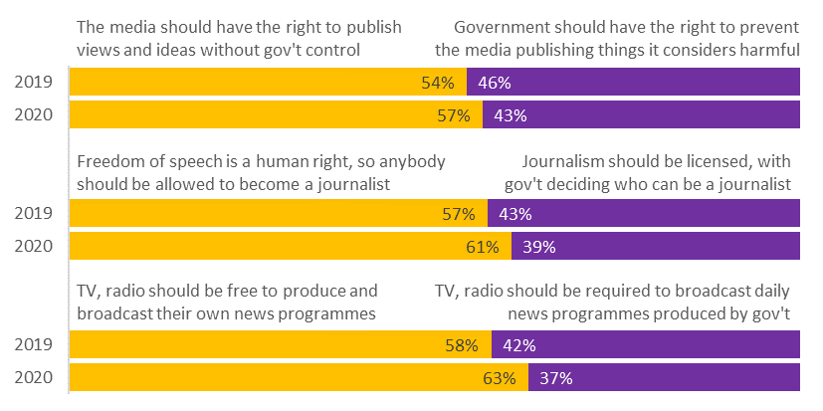
In Uganda, most citizens say the media should have freedom to work without government interference
Uganda: From each pair of statements, which do you agree with more?
Source: Sauti za Wananchi Mobile Phone Panel Surveys, 2019-2020

Slide 5
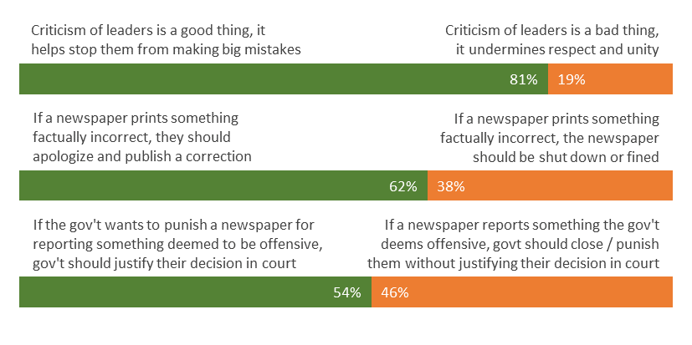
Similarly, in Tanzania, most support media freedom and limits on government powers to intervene
Tanzania: From each pair of statements, which do you agree with more?
Source: Sauti za Wananchi Mobile Phone Panel Survey, 2017

Slide 6
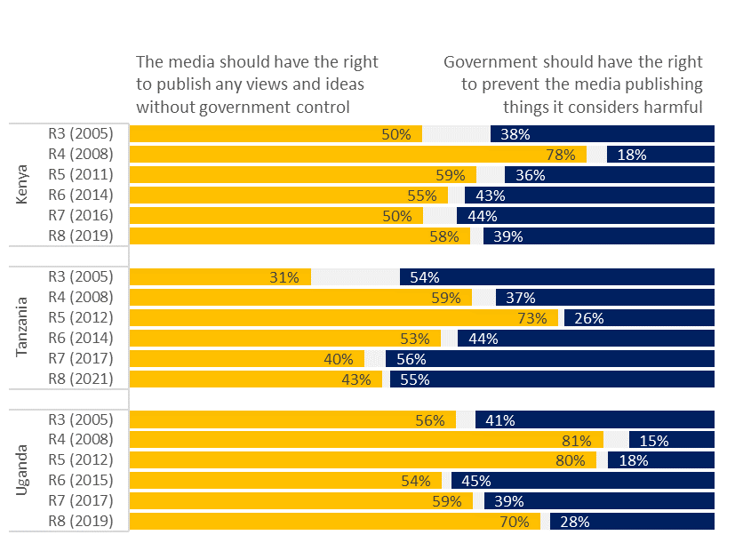
Overall support for media freedom in East Africa has risen and fallen over recent years
Which statement do you agree with more?
Source: Afrobarometer Public Opinion Surveys, 2005-2021

Slide 7
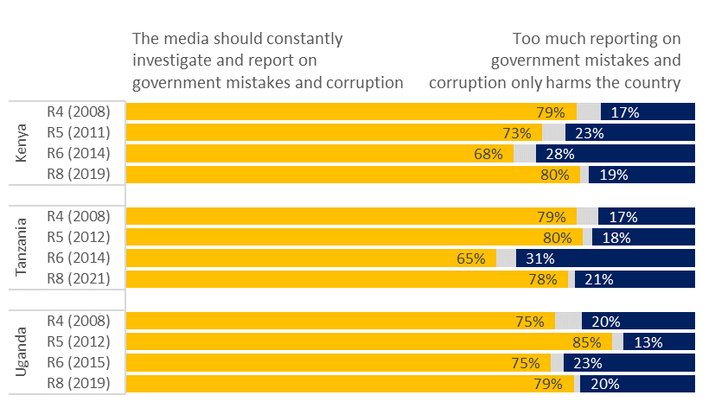
But citizens believe strongly that media reporting on government mistakes and corruption is a good thing
Which statement do you agree with more?
Source: Afrobarometer Public Opinion Surveys, 2005-2021

Slide 8
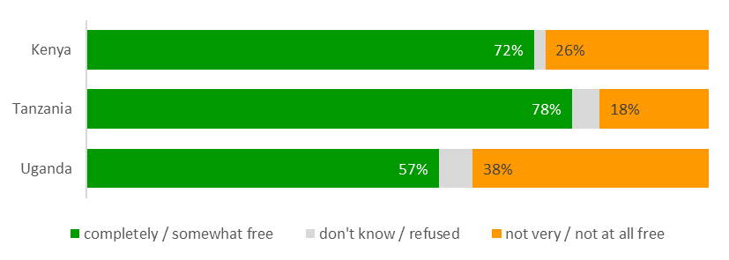
Citizens also believe the media is currently free to report and comment on the news
In your view, how free is the media in this country to report and comment on the news without government interference?
Source: Afrobarometer Public Opinion Surveys, 2019-2021

Slide 9
impact of digital media
2

Slide 10
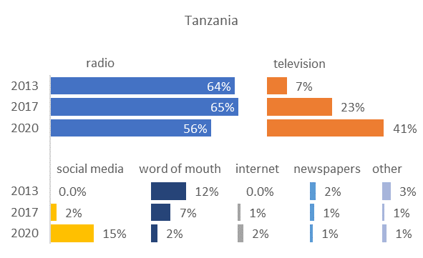
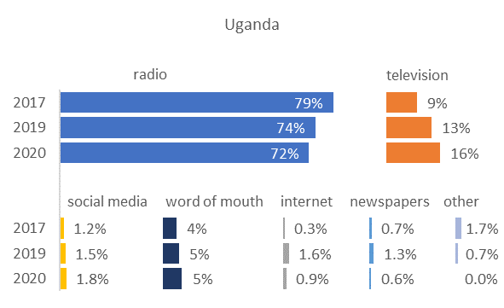
Radio is still citizens’ main source of information, but tv and social media are growing (especially in Tz)
Which media is your main source of information?
Source: Sauti za Wananchi Mobile Phone Panel Surveys, 2013-2020

Slide 11
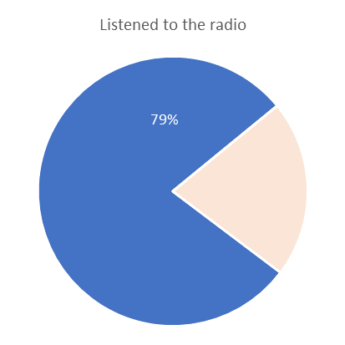
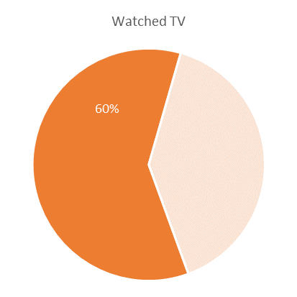
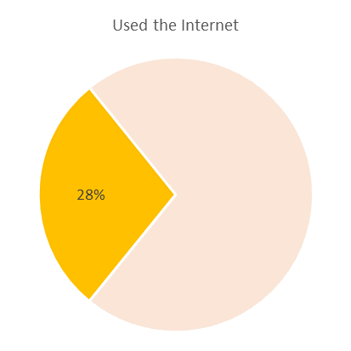
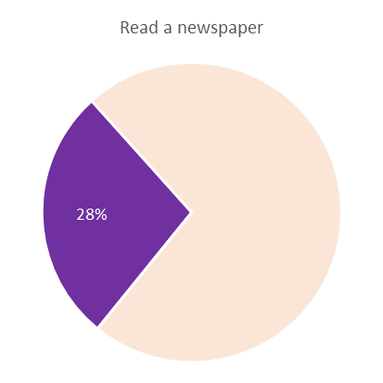
Radio and TV are also the dominant sources of information in Kenya
Kenya: % who did the following at least once in the previous week:
Source: Sauti za Wananchi Mobile Phone Panel Survey, 2018

Slide 12
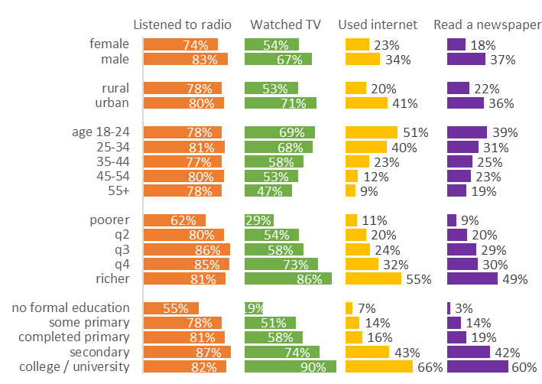
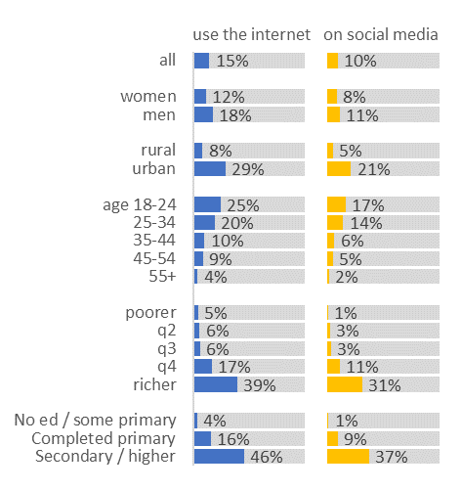
Radio is used by all, but TV, internet, social media are dominated by the young, wealthy, urban and educated
Uganda: Do you use the internet / are you a member of social networking site?
Kenya: % who did the following at least once in the previous week:
Source: Sauti za Wananchi Mobile Phone Panel Surveys, Kenya 2018 and Uganda 2021

Slide 13
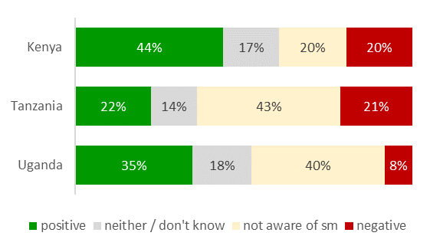
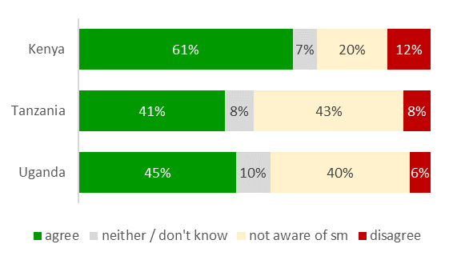
Citizens see social media overall as a good thing that helps people have more impact on politics
Overall, do you think that the effects of social media on society are mostly positive or negative?
Do you agree or disagree: Social media helps people have more impact on political processes?
Source: Afrobarometer Public Opinion Surveys, 2019-2021

Slide 14
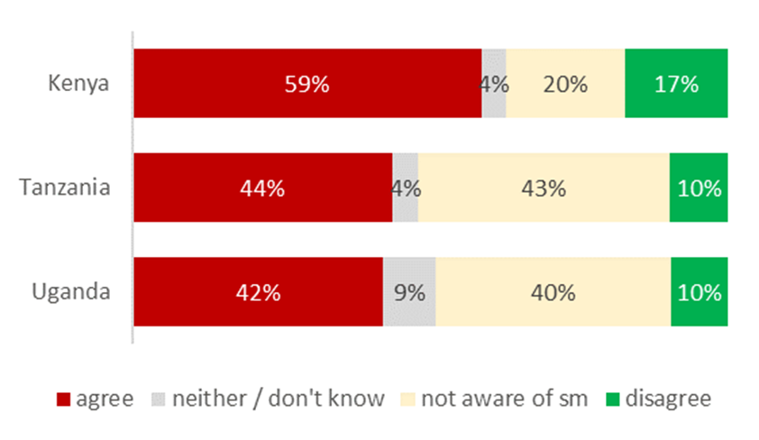
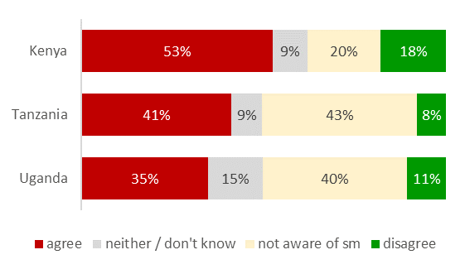
However, citizens also have concerns about the effect of social media on fake news and intolerance
Do you agree or disagree: Social media makes people more likely to believe false news?
Agree or disagree: Social media makes people more intolerant of those with different political opinions?
Source: Afrobarometer Public Opinion Surveys, 2019-2021

Slide 15
Most citizens think unrestricted access to the internet and social media should be protected, less so in Kenya
Should unrestricted access to the internet and social media be protected, or should this be regulated?
Source: Afrobarometer Public Opinion Surveys, 2019-2021

Slide 16
Trust in the media
3

Slide 17
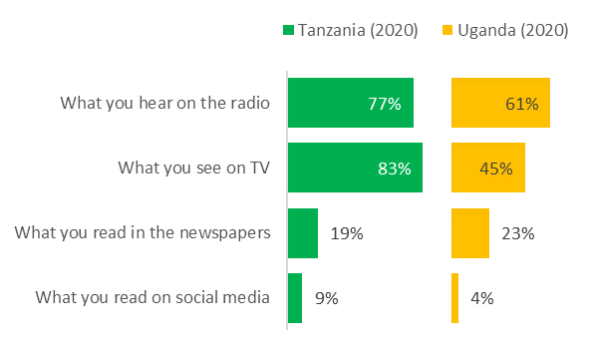
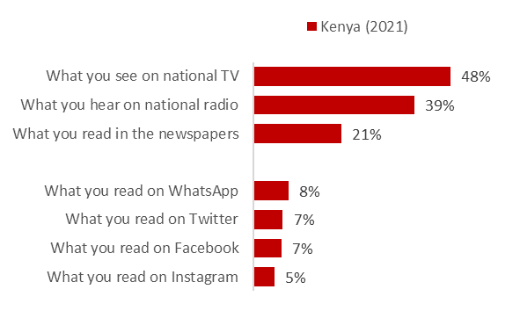
Trust is much higher in information from radio and TV than from social media
% who trust "completely" information
from the following sources:
% who trust “very much" information
from the following sources:
Source: Sauti za Wananchi Mobile Phone Panel Surveys, 2020-2021

Slide 18
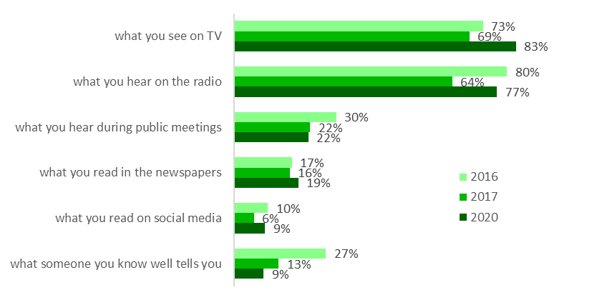
TV and radio have consistently been the most trusted across recent years, while trust in people has fallen
Tanzania: % who trust "completely" information from the following sources:
Source: Sauti za Wananchi Mobile Phone Panel Surveys, 2016-2020

Slide 19
The Media at KEY moments
4

Slide 20
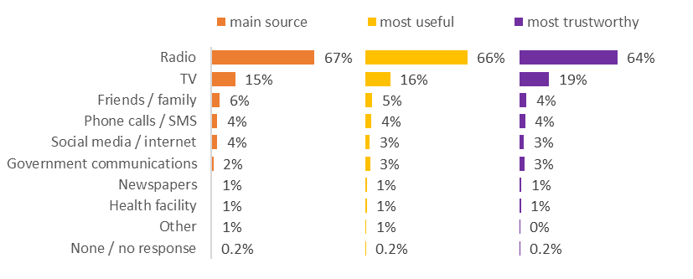
In Uganda, when the Coronavirus pandemic struck, people looked mainly to TV and radio for information
Uganda: What has been your main source of information about Covid-19? Which was the most useful / most trustworthy?
Source: Sauti za Wananchi Mobile Phone Panel Surveys, 2020

Slide 21
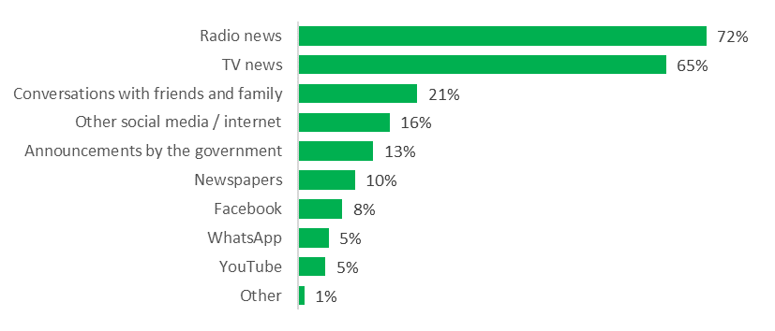
Similarly, in Tanzania, citizens seek information about Covid-19 vaccines mainly from radio and TV news
Tanzania: From which of the following sources have you heard about vaccines against Covid-19?
Source: Sauti za Wananchi Mobile Phone Panel Surveys, 2016-2020

Slide 22
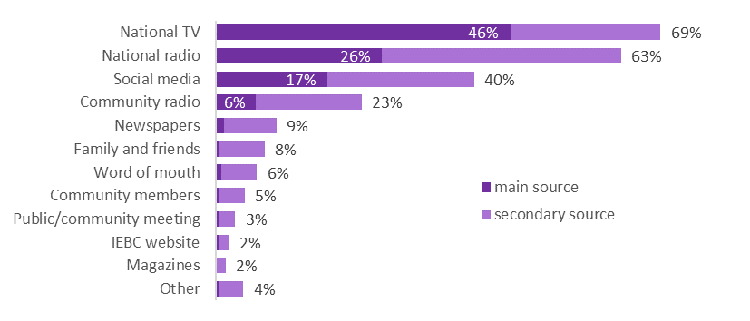
And in Kenya, citizens still primarily use turn to TV and radio for news on election-related matters
Kenya: Which of the following have been your sources of information/news over the last four weeks on election matters?
Source: Sauti za Wananchi Mobile Phone Panel Surveys, 2021-22

Slide 23
MEDIA AND Democracy
5

Slide 24
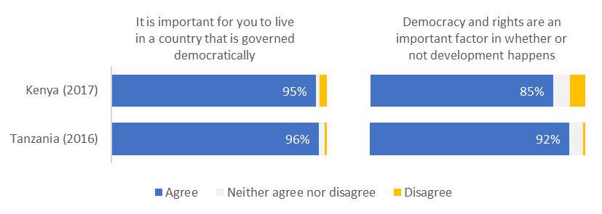
In Kenya and Tanzania, almost all say it is important to live in a country that is governed democratically
How much do you agree or disagree with the following statements?
Source: Sauti za Wananchi Mobile Phone Panel Surveys, 2016 (Tz) and 2017 (Ke)

Slide 25
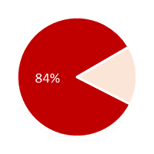
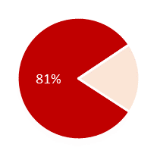
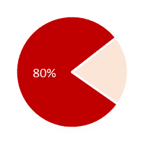
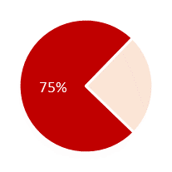
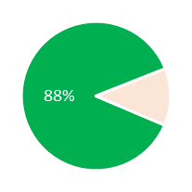
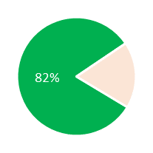
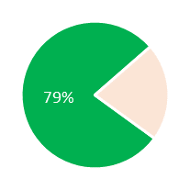
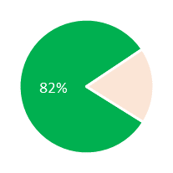
Independent media, freedom of expression and access to info are all seen as vital to democracy
% who say the following are "very important" as characteristics of democracy:
Citizens are free to criticise the govt when they think it has done wrong
Strong, independent institutions monitor the govt to ensure it is doing its job
Info about what the govt is doing, including the budget, is easily available to citizens
The media is able to operate independently
Kenya (2017)
Tanzania (2016)
Source: Sauti za Wananchi Mobile Phone Panel Surveys, 2016 (Tz) and 2017 (Ke)

Slide 26
Asanteni
www.twaweza.org

